Slide 1

Finding Academic Information
Library and Information Services

Slide 2
Aims
Use online catalogue (LibrarySearch)
Use subject databases
Use the web
Evaluate resources

Slide 3
Starting your search
Start with your reading list
Where can I search?
Library catalogue- searches everything
Databases- searches subject specific

Slide 4
Why do we need to find information?
Provide evidence
Demonstrates reading
Generate ideas
Pass your assignment!

Slide 5
Why do you need a search strategy?
Stay in control of your search
Clear about what information you need

Slide 6
Search Strategy - Think about
Make sure you understand the question
Time available/deadline
Amount of information required
Search words/ keywords to be used
Type of resources

Slide 7
What information?
Books
Overview
Introduction
Journals
Specific subject
Detailed information
Current
Internet
Social media (blogs / Twitter)
Email alerts / RSS feeds
Online forums
Reference
Short summary
Facts and figures

Slide 8
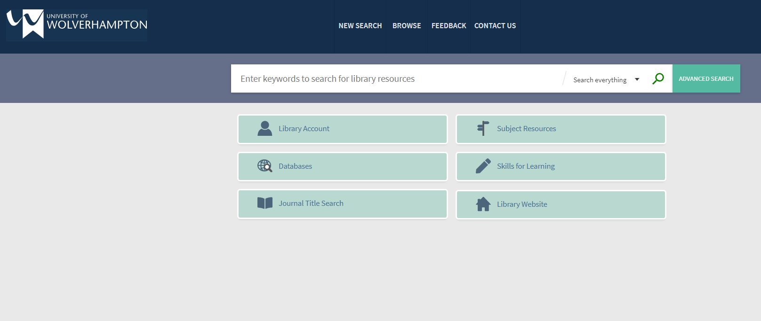
Library Catalogue (LibrarySearch)

Slide 9
Subject databases
Subject resources
Chosen by Directorate of Academic Support
Mainly full text
Accessed via Canvas/ Subject resources

Slide 10
Generating search words
Subject words
Alternative words- UK/US spellings
Focus- country, date

Slide 11
Search Terms
When you have identified your search terms, try to think of:
Synonyms
Alternative terms
Alternative spellings
Alternative formats

Slide 12
Search Options
Different databases offer different options for refining results.
Full text
Peer reviewed
Date
Language
These tend to be standard.

Slide 13
Using keywords
Alternative terms
Level of description
Elderly
Aged
Pensioner
Senior citizen
Marketing Performance
Management
Marketing Performance
Marketing

Slide 14
Boolean logic
AND
e.g. Car AND Motorbike
OR
e.g. Car OR Motorbike
NOT
e.g. Car NOT Motorbike

Slide 15
Truncation
‘*’
For example;
Business*
Would bring back any word that starts with ‘business' and has any kind of ending. For example;
Businessman, businesswomen etc.
Notes:
Demo…

Slide 16
Phrase searching
“social media”
“driverless cars”

Slide 17
Wildcard searching
Organi?ation
Looks for any character, but does not an absence of a character
e.g.
Organisation and organization
Notes:
You may be able to replace one or more letters within a word by using a character, often a question mark (?). Allows for multiple spellings of a word.

Slide 18
Wildcard searching
Behavio#r
Searches for any, or no, characters
e.g.
Behaviour and Behavior
Notes:
You may be able to replace one or more letters within a word by using a character, often a question mark (?). Allows for multiple spellings of a word.

Slide 19
Search options
Extra limiters may include:
Gender
Ethnicity
Age
Geographical area
Methodology
Document type

Slide 20
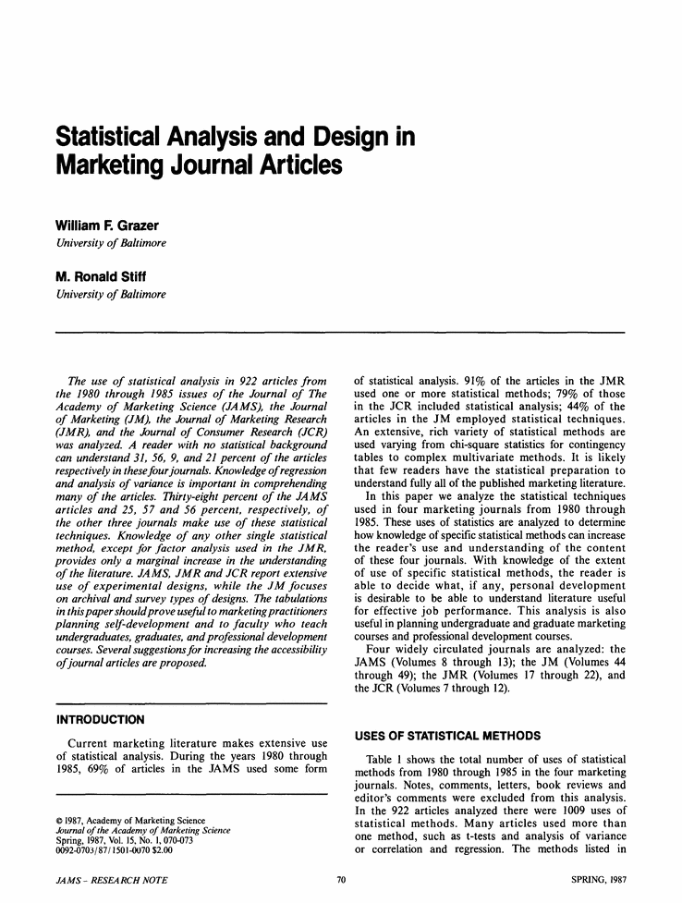


Journals

Slide 21
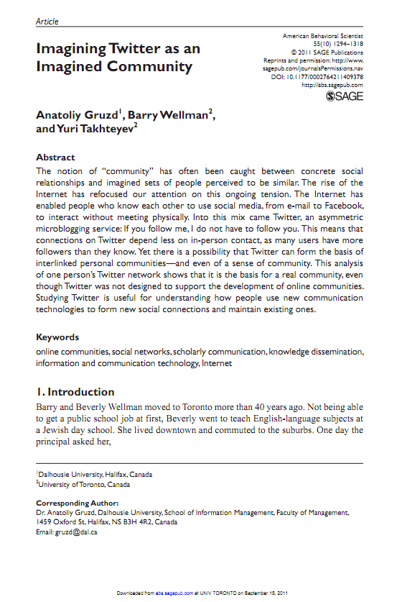
Reading Journal articles
A useful tip is to read the abstract
for a brief summary of the article.
This will help you decide if the
article is relevant.
Look out for keywords.
Check reference lists for
related reading.
Notes:
Initially read the abstract of journal articles to identify its relevance.
Skim read for keywords. These may provide useful search terms.
The reference list of a useful article may provide details of further articles and sources relevant to your interests.
Ask group whether they are happy with using Summon and databases. Recommend further workshops, or demo, if not.
Impact factor; “Measure reflecting the average number of citations to recent articles published in the journal.”
Journal citation factors- Web of knowledge.

Slide 22

Searching the Library Catalogue
Have a go at
task 1
on the worksheet

Slide 23

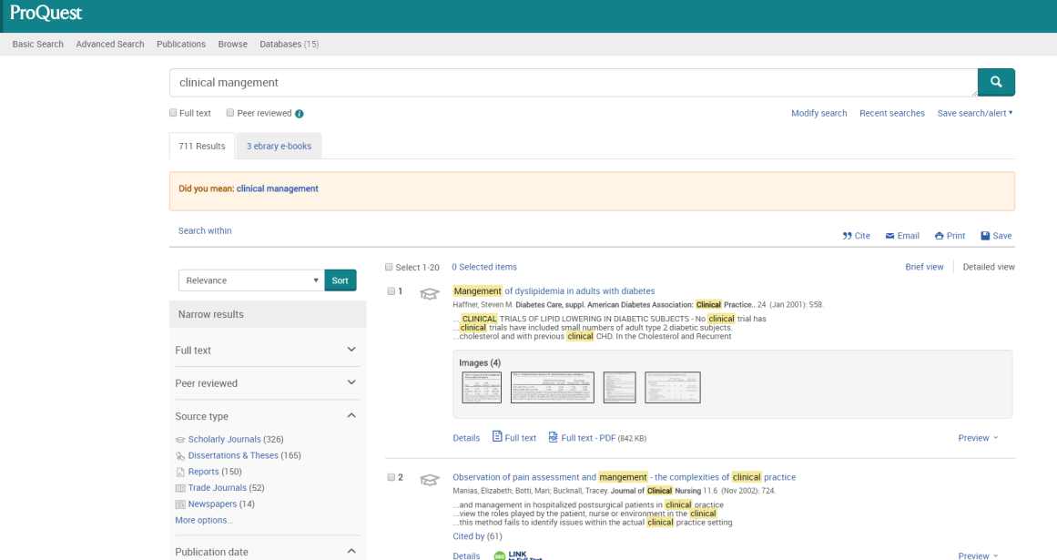
Library Catalogue or Databases?
Vs

Slide 24
Library catalogue- LibrarySearch
Advantages +
Searches all subject areas and publication in one go.
See all matching results from books, journals, newspaper articles on one page- good place to start
Disadvantages -
Advanced search can be limited
Not subject specific

Slide 25
Subject databases
Advantages +
Subject specific- results are more relevant
Advanced searching often available to search in specific fields
Disadvantages -
May have to search in multiple database to get full range of results

Slide 26

Searching subject databases
Have a go at
task 2
on the worksheet

Slide 27
Searching the web
Be careful using web resources
When to use the web
How to evaluate information found on the web

Slide 28
Be careful using web resources
Overkill- will our resources suffice?
Anyone can publish
Leave it there as long as they like
Change or remove without warning
No formal publishing process
Lose marks for using unreliable website

Slide 29
When to use the Web
May be the first port of call for information
Quick reference (e.g. online dictionaries)
Organisations and societies
News/directories
Used to supplement academic research
Can be used for academic research
Google Scholar

Slide 30
Basics of searching…
Keep it simple
Make one change at a time
Broad → narrow
(add more keywords)

Slide 31
How to evaluate
Authorship
Accuracy
Currency
Purpose / bias
Usability
Level

Slide 32
Matrix Grid
 | Article one | Article two | Article three
Research question | To quantify health impact of increasing the price of alcohol across Europe. | 2012 update of Sheffield Alcohol Policy Model for population of Scotland | News article
Methodology | Dynamically project changes in population health using alcohol consumption data and corresponding country disease data. | Statistical modelling. | None given. Statements made without any evidence provided in support.
Results | Increasing price of alcohol to Finnish model would postpone significant numbers of alcohol related deaths over 10 years and lead to a reduction in chronic diseases. | A minimum price increase will result in a decrease in alcohol-related hospital admissions and deaths. Also result in a decrease in alcohol-related crimes, absenteeism from work and unemployment from work due to alcohol-related problems. | Minimum pricing policy is regressive taxation, there is no evidence to back up health benefit claims and illegal under European law.
Conclusions | Reducing excessive drinking in EU would result in significant gains in population health. | A minimum price increase will result in a decrease in alcohol-related hospital admissions, deaths, crimes, absenteeism. | Minimum pricing policy wouldn’t address health claims and has other negative side effects for society.
Weaknesses | Conceptual, predictive study. | Conceptual, predictive study. | No evidence to back up claims.
Notes:
Literature review matrix- created in Word, powerpoint or excel. Allows you to compare/contrast sources more easily.
Use your own set of criteria/themes. Try not to force sources to fit into your boxes, possibly have an ‘other’ box for interesting points that don’t necessarily fit.

Slide 33
Summary
Decide upon your search words
Have a search strategy
Think about what resources to use
Keep a record of your search

Slide 34




Useful Links
Skills for Learning
www.wlv.ac.uk/skills
ASSIST – Online chat service
www.wlv.ac.uk/lib/assist
Learning Centres
www.wlv.ac.uk/lib
Find us on Facebook www.facebook.com/wlvskills
Follow us on Twitter www.twitter.com/wlv_skills
Watch us on YouTube http://bit.ly/13LxOkd

Slide 35


